Slide 1
세상 모든 자연과 통하다
GLOBAL ECO THE SAEM
Gem Miracle Black Pearl
O2 Bubble Mask Sheet

Slide 2
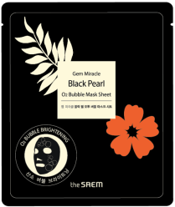
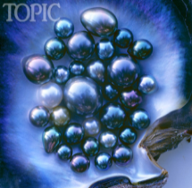
Profile of Gem Miracle Black Pearl O2 Bubble Mask Sheet
Product Name | Gem Miracle Black Pearl O2 Bubble Mask Sheet
Concept | Innovative ! Dramatic ! Different ! Powerful skin detoxifying mask sheet that works with oxygen to add a new life into lackluster complexion.
TARGET | Customer living in a highly polluted area When you feel that your skincare products are not working well. (Need an elimination of dead cells) When the makeup doesn’t sit well on the skin. You are worried about the enlarged pores. You need to brighten up for special occasion.
Price | Korean Retail Selling Price (KRSP) : ₩5,000
How does it work? | Porous powders in the product adsorb all the impurities such as pollutants, toxins, makeup residue. Oxygen carrier meets the air, then forms abundant bubbles while purifying & invigorating the skin. Contained AHA & BHA eliminate unwanted dead cells in the skin and pores. Skin is now free of unwanted dead skin, toxins and roughness. Tahiti black pearl and other hydrating ingredients give softness, luminosity to the skin. Overall complexion is now BRIGHTER.
Ingredients
※ Compared to the existing O2 Bubble mask, the concept Ingredients are more intensified and upgraded in both quality and quantity.
Tahiti Black Pearl : Tahiti is known for the best quality Black Pearl. Its value is beyond others due to the rareness.
It supplies marine energy and radiance to the skin.
Porous powder : Adsorbs impurities
AHA & BHA : works deeply in the skin to remove dead skin cells
Purslane + Glycerine + Green tea : provide softening & silkiness.

Slide 3
Using Directions & Benefit Review
Step 1: Due to the originality of the content, the content may sink to the bottom. Prior to use, you should rub the package in circular motion so that the sheet can maximize the absorption of contents.
Step 2: Wear the mask on a clean face.
Step 3: After 5- 10 minutes, when enough oxygen bubbles are formed, take off the sheet. Use the remaining bubble to massage the face for a couple of minutes.
Step 4: Wash off well with lukewarm water.
Benefit Review
1
2
3
NO MORE IMPURITIES (such as pollutants, toxins, makeup residues on a skin).
NO MORE UNWANTED DEAD SKIN CELLS
PORE IS DEEPLY CLEANED.
(AHA & BHA reduces the chance of breakout)
4
5
6
TAHITI BLACK PEARL GIVES LUMINOSITY
SOFT & SILKY
(Hydrating agent:
Purslane, green tea, glycerine)
Overall complexion: BRIGHT !
PURE!
YOUNGER!

